Slide 1
Handcrafted Harmony
…Delivering quality from our hands to yours

Slide 2
795,321
Big numbers catch your audience’s attention

Slide 3
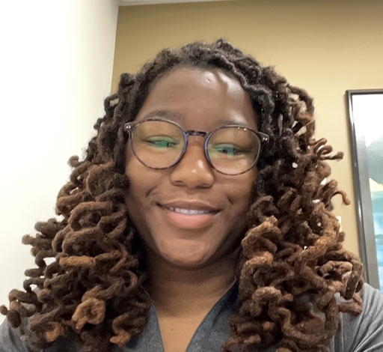

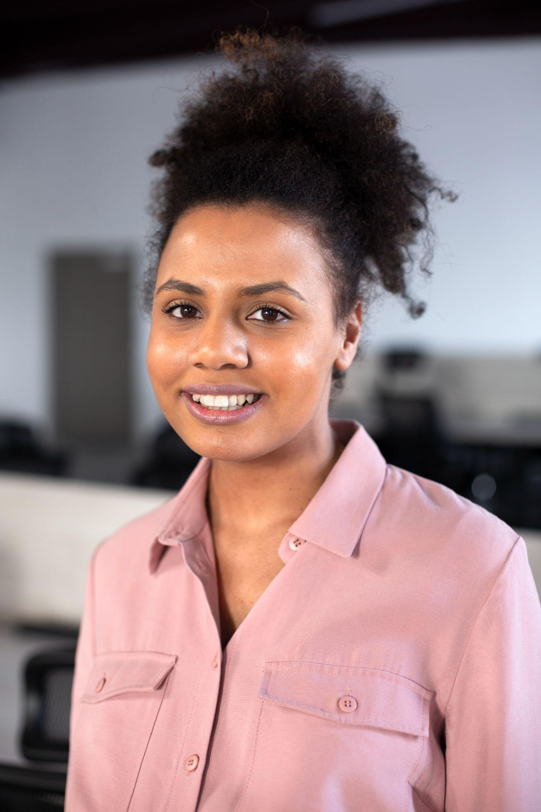
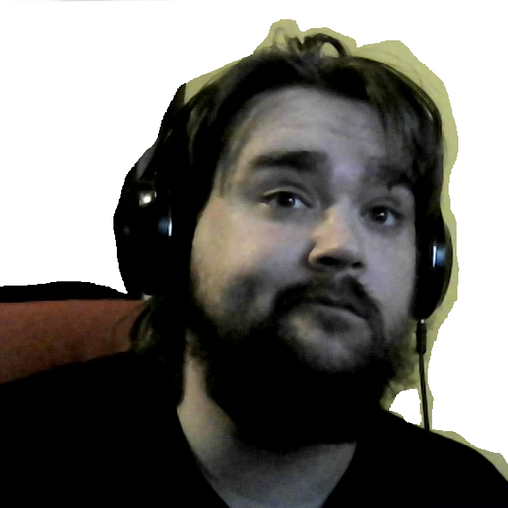


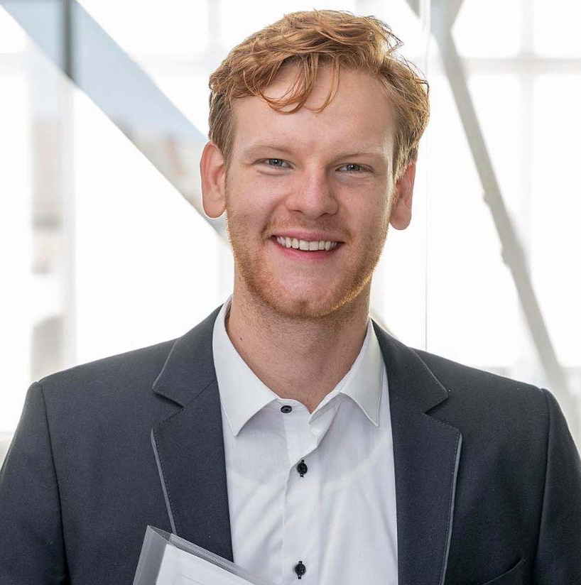

Our team
Zuwadi Brown
Andrew Cerna
Seth Eggenburg
Jonathan Hummer
Antonina Stancheva
CSS, Bootstrap, dark/light mode
Interfaces, Shop, Sell
Utils, Routes, Deployment
Database Design, Product Tiles
Endpoints, Cart Design, Modals
Notes:
Making things pretty
Making things work
Making things easy
Making things polished

Slide 4
Table of contents
01
02
03
Introduction
Concept
Process
04
05
Demo
Development
Describe the topic of the section here
Describe the topic of the section here
Describe the topic of the section here
Describe the topic of the section here
Describe the topic of the section here
Notes:
01 – Jonathan
02 – Andrew
03 – Antonina
04 – Zuwadi
05 – Seth

Slide 5

01
Introduction
Why are we here?
Notes:
Jonathan

Slide 6
—Someone Famous
“You can buy anything in this world with money.”

Slide 7

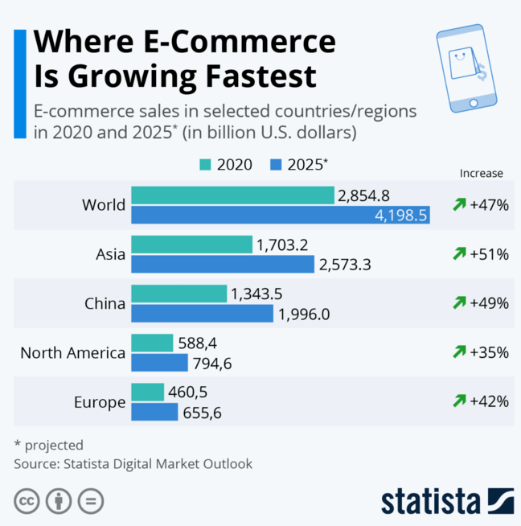
People Love Buying Online
Do you know what helps you make your point clear? Lists like this one:
Because they’re simple
You can organize your ideas clearly
And because you’ll never forget to buy milk!
And the most important thing: the audience won’t miss the point of your presentation. Let’s use lists!

Slide 8
Whoa!
That’s a lot of eCommerce…
…how can I get in on that action?

Slide 9
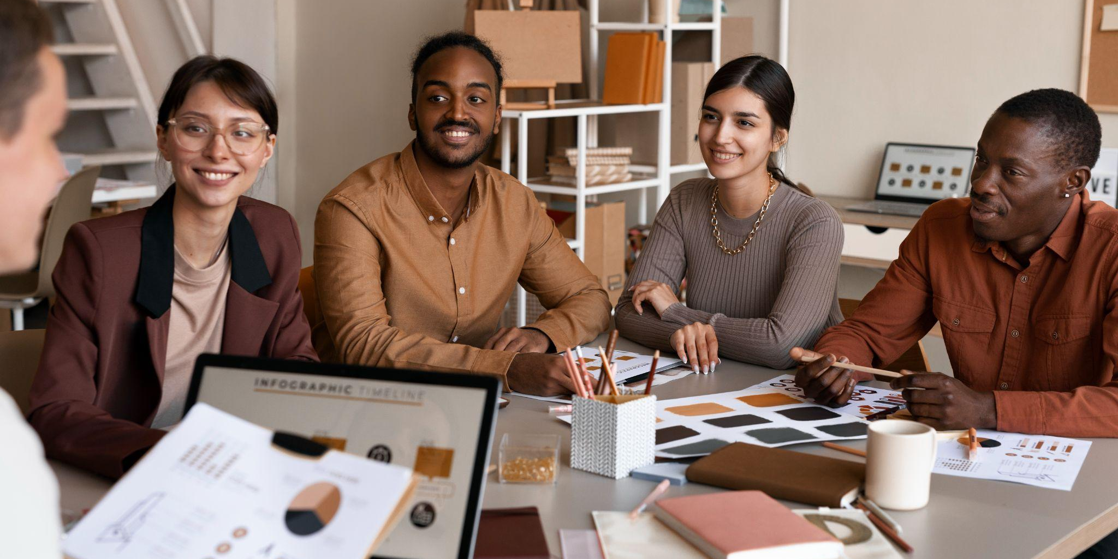
Concept
02
Insert a subtitle here if you need it (we don’t)
Notes:
Andrew

Slide 10
This is an infographic
Products
Ideas
Seller
Buyer
Money
Post cool artisan products on an interactive website for users to browse.
Share ideas and give feedback
Seamless purchases
Notes:
We created Handcrafted Harmony to fill a gap in the e-commerce space—an inclusive, community-driven platform focused solely on handmade goods. Inspired by the growing maker movement and the rise of independent creators, our goal was to empower artists and small business owners by giving them a digital storefront that’s tailored to their needs. We also wanted to offer shoppers a space where every item tells a story and quality craftsmanship is front and center.

Slide 11


User Story
As a handmade goods enthusiast, I want to spend money. I want a platform where I can browse and purchase unique, artisan-made items while supporting independent creators.
As a seller, I want to make money. I want an easy-to-use marketplace to showcase my handmade products, manage inventory, and connect directly with buyers who value craftsmanship.

Slide 12
Handcrafted Harmony is a unique online marketplace exclusively for handmade goods, giving artisans a platform to sell their creations directly to buyers. Whether it’s jewelry, home decor, or art, our site connects makers with shoppers who value craftsmanship. With features like user authentication, customizable product listings, an interactive cart, and a spotlight on a featured seller and product each month, we’re building a curated community around creativity. Built with React, Node.js, and Sequelize, Handcrafted Harmony is where handmade meets high-tech.

Slide 13
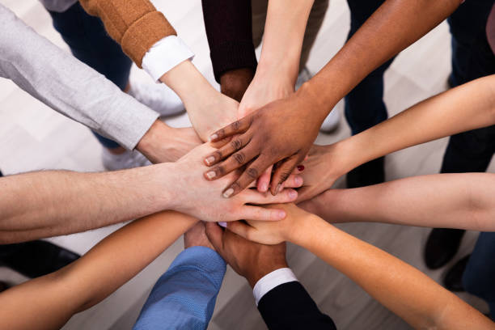
03
Process
How did we go about this endeavor?
Notes:
Antonina

Slide 14

Really Impressive Stuff, Guys
Technologies
Frontend: React.js, HTML, CSS, TypeScript
Backend: Node.js, Express.js
Database: Sequelize
Authentication: JWT (JSON Web Tokens)
Deployment: Render (https://project-2-shop.onrender.com)
Challenges
Successes
Linking databases with aliases
Tracking variable names/routes
Routing issues: UseNavigate()
Deploy to Render
Polished design, CSS, modals
Databases worked
Communication & Collaboration
Practical application of skills

Slide 15
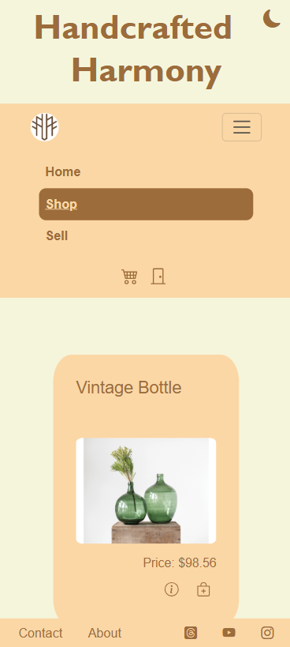
Mobile web
Responsive design so you can browse anywhere!

Slide 16
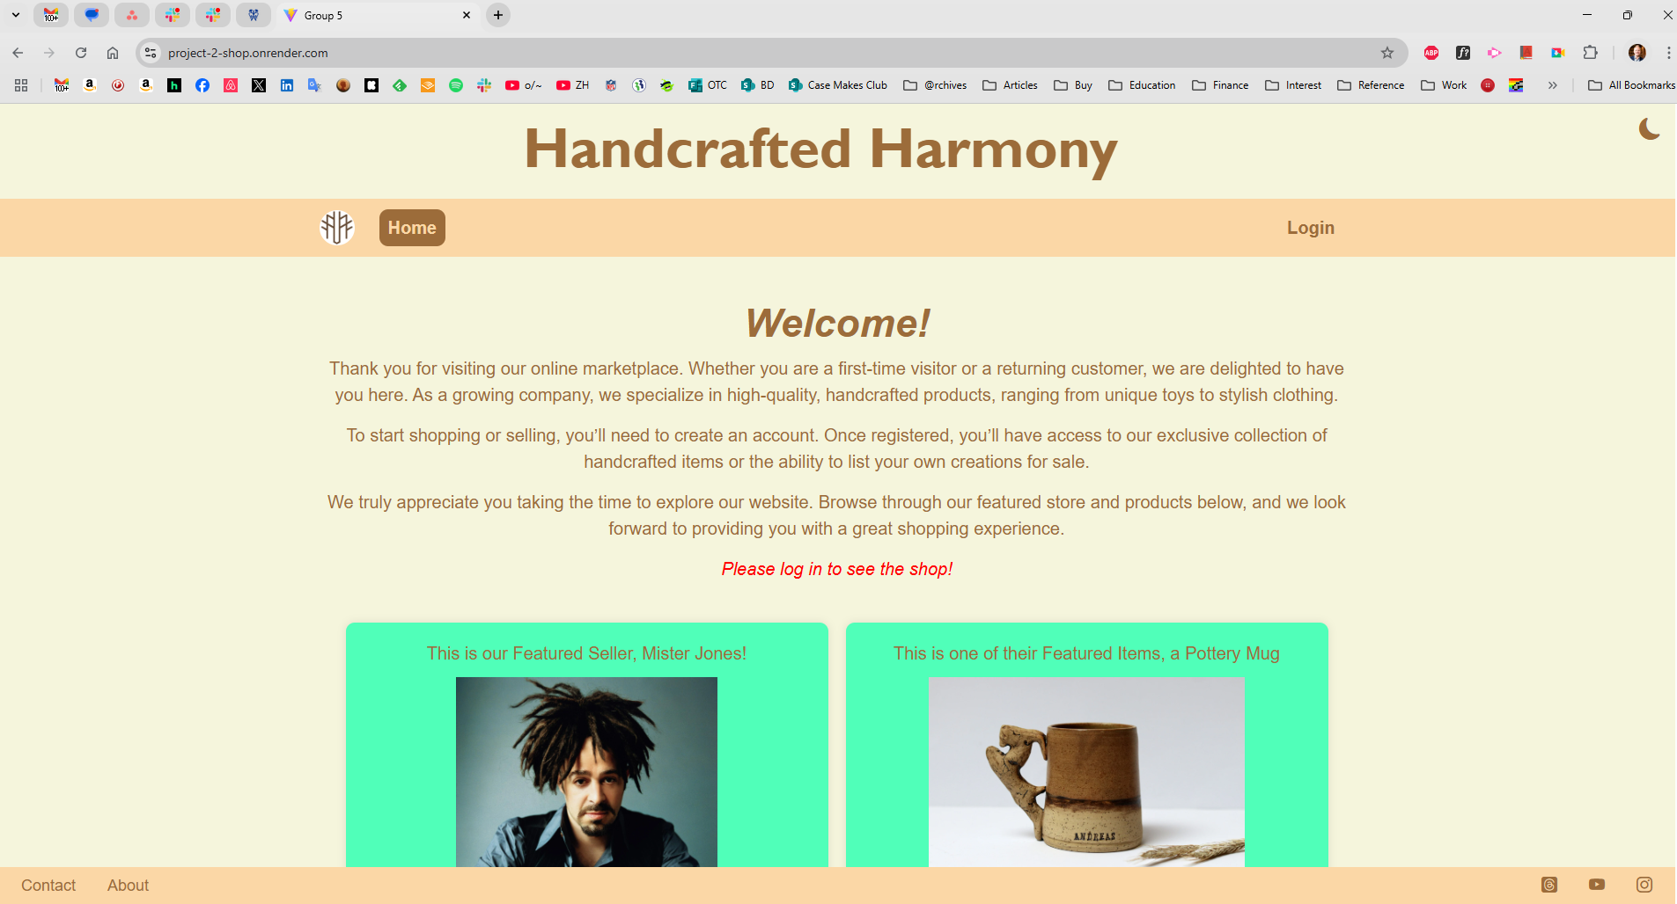
Desktop Version

Slide 17
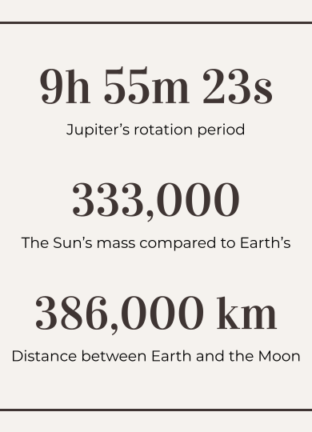
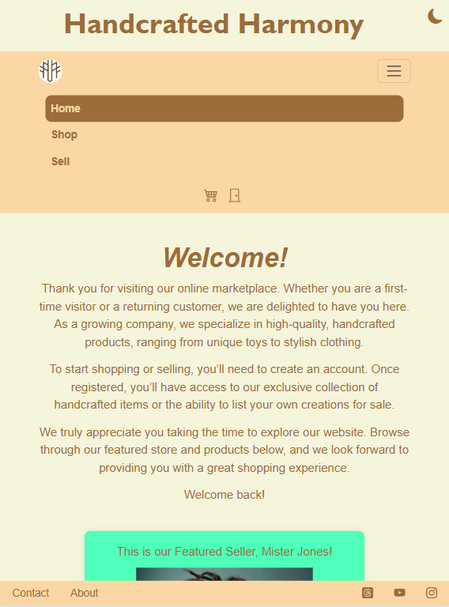
Tablet app
Sleek interface and seamless user interface

Slide 18
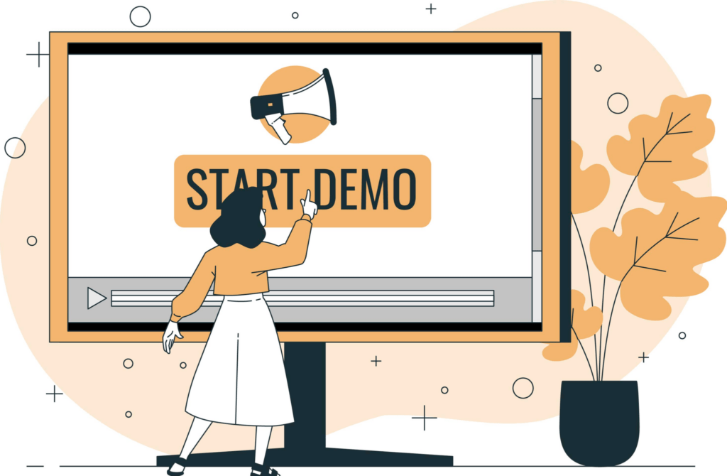
Demonstration
04
Buckle up.
Notes:
Zuwadi

Slide 19
https://project-2-shop.onrender.com

Slide 20
05
Future Development
Where do we go from here?
Notes:
Seth

Slide 21
Development
Things to Make it Perfect
Search & Filters: Buyers can search for products by category, price, or keyword.
Order Management: Sellers can track and manage their orders.
Ratings & Reviews: Buyers can leave reviews for products they've purchased.
Secure Payments: Integrated payment gateway to securely handle transactions (e.g., Stripe).
Live Inventory: Adjust quantities available for sale for a given item, Cart quantities to buy
Profile Management: Toggle between buyer/seller, update username, password, and email
Seller Pages: To create a public profile and manage orders
By the numbers:
80%
Level of perfection
100%
Grade deserved for this Project

Slide 22
Awesome words
Any questions?

Slide 23
Links
Try Me: https://project-2-shop.onrender.com
Fork Me: https://github.com/p2t5-Group-5/Project-2

Slide 24
Thanks
Do you have any questions?
+800 867-5309
handcraftedharmoney.com
We’ll get back with you shortly!
Please keep this slide for attribution

